Slide 1
Interfaces (or Who Will Clean the Spouting?)
IN710 OOSD 2017
Session 2.1b
Notes:
This will be more or less a review for some of you. If you already know it, just be patient, and note that we go into the interface in much more depth in this paper than in other papers.
At the core of OO design is the categorisation, or grouping, of classes.
We note that cats and dogs have things in common, so we can group them into “mammals”
We then place those commonalities in the mammals base class, gaining all the advantages we have already discussed.
Further, we can say that grasshoppers and fleas have some things in common with cats and dogs, but they are not as close, they are not mammals.
So we make another group “insect” for them, and place both insect and mammal as children of “animal”
We can thus precisely capture the very common hierarchical relationships between entities: In speaking we would call these “is a” relationships.
A cat is a mammal; An insect is an animal.
There is, however, another principle under which we might group or categorise things, obtaining similar advantages in terms of encapsulation, abstraction, reusability, etc., that we get from the classic inheritance relationship described above: based on what a thing can do.
There is some overlap here, of course, because if A is a B, then of course A can do what B can do.
But sometimes, two classes can do the same things, even though they have no inheritance (is a) relationship.
For example, each spring, the spouting on my house needs to be cleaned. I can call the plumber or the builder. Each of them has, if you will, a CleanSpouting() method.
They do this job differently (polymorphically). The builder gets a big ladder and climbs it to reach the second floor. He uses a water hose. The plumber puts on a rope and climbs out the upstairs windows. He uses a shovel and a bucket. But I don’t care. As long as the spouting is cleaned, they can do whatever they like.
Someone might propose making a base class “HomeMaintenancePerson” that has various descendent branches and one of them includes all the HomeMaintenancePersons who CleanSpouting.
You might be able to make something sensible here (although it would be tricky), but the problem is more complicated, because sometimes the spouting is actually cleaned by an instance of the Husband class, and there is basically no sensible object hierarchy that connects Husband and HomeMaintenancePerson and lets them both have CleanSpouting without making a big mess (specifically a whole bunch of classes that have the method but don’t need it, and that’s just bad OO).
In this case, the commonality of Plumber and Husband is not what they are it is what they do.
I just want to be able to identify an object as “one of those classes that can clean spouting”. I don’t care about how they do it, or what else they know (fields) or can do (methods).
C# provides a mechanism for expressing this kind of categorisation, and it is very useful. It is called “interfaces”

Slide 2
Interfaces vs Parent Class
Set of things I can do…
Parent
Interface 1
Things I inherit because I am a…
Class
Interface 2
Set of things I can do…
Interface 3
Set of things I can do…
Notes:
Note three things:
Interfaces always contain sets of methods that are logically related in some way (cohesion). Otherwise it would get very confusing, and you would end up with objects having methods they didn’t need.
Objects can implement as many interfaces as you think they need. Note that this is different from inheritance: in C# you can only inherit from one parent class.
Once you have defined an interface (a set of things to do), any class can implement it, regardless of its inheritance hierarchy
In our previous example….

Slide 3
Interfaces vs Parent Class
HomeMaintenancePerson
Interface
CleanSpouting()
FamilyMember
Builder
Husband
Notes:
In our previous example….
Builder descends from HomeMaintenancePerson; Husband descends from FamilyMember. Each has the fields and methods common to their inheritance hierarchy, which is sensible. (Can you think of some examples…?). They have little in common, so should descend from different parent classes.
Both Builder and Husband implement the “Clean Spouting” interface. That is, they both expose a CleanSpouting() method. The code for that method is probably very different, but this is not relevant to the user.
Why is this useful when coding?
As long as I know that both the builder and husband classes implement the Interface containing CleanSpouting(), I can say with confidence BuilderInstance.CleanSpouting() or HusbandInstance.CleanSpouting() and know that this code will work.
As a language feature, there is, of course, compiler support.
You have actually seen this already in C#, where interfaces are very important.
For example, C# has the “IEnumerable” interface. IEnumerable is a set of methods for collection operations like “find the next element , and “tell me how many elements”
If you look at the definitions of .NET classes List, Array, Dictionary, etc., you will see that they all implement IEnumerable (we will see the syntax in a moment). That’s why you can put any of these into a foreach loop. Because the foreach loop implementation needs “find the next element in the collection”. It doesn’t care at all how that happens. It just cares that when it says “give me the next one” it gets the next one.
Let’s look at the syntax, and then you’ll work with interfaces in the practical.

Slide 4
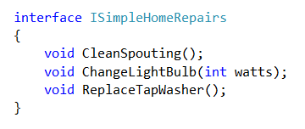
Defining an Interface
Notes:
Structurally, an interface is a user-defined type (just like a class is a user-defined type), so adding an interface to your project is much the same as adding a class.
Scope “public” if you want other classes to be able to see it
With a project open in VS2013, select Project -> Add New Item ->Interface, and you’ll get a little skeleton for your interface
Use the keyword interface.
The I prefix is conventional only, but it is a pretty strictly followed convention
Define the methods in your interface by giving the function prototype. NO CODE BODIES. Interfaces are implemented polymorphically. All they do is define a list of functions.
Any object that implements this interface *must* provide code for every function, or it will not compile.
In this example, these all return void, but that’s just coincidence. You can have any legal C# function prototype.
Thus any code that uses an instance of a class that implements a specific interface can know with certainty that all the methods in that interface are covered.
This is why an interface is often described as a “contract” – implementers of the interface promise to provide the specified functionality
Note that there are no access modifiers (private, public, etc.). All methods in an interface are, by definition, public.
Note that there are no fields. Interfaces *only* describe functionality. (Question: Can you have properties? Answer: Yes, because properties are really methods, spec. set and get)
Note that there are no method bodies. Interfaces *never* say how something is done, only that it will be available.
(Think here about the difference between how interfaces and classes implement polymorphism. We will discuss this further in a minute….)

Slide 5
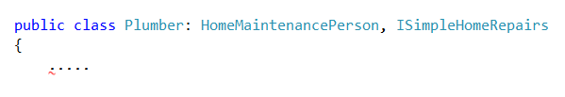

Implementing an Interface
Notes:
The base class always comes first, and there can be only one (or zero – it is not necessary to be a child class to implement interfaces)
Then you can have zero or more interfaces, all separated by commas.
The order of the interfaces doesn’t matter – all methods in all interfaces must be implemented

Slide 6
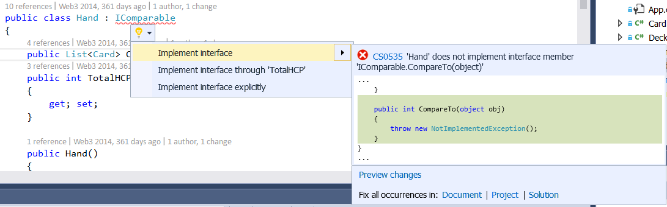
Implementing an Interface
Notes:
The IDE will help you make sure all your methods get written…
Right-click on the interface declaration, select Quick Actions, then Implement interface.
You can, of course, also do it manually if that is your preference.

Slide 7
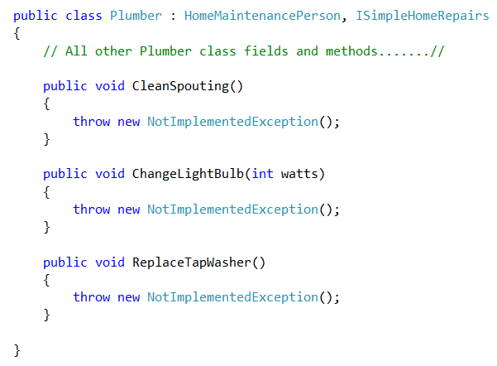
Implementing an Interface
Notes:
Here’s what you get
Just replace the exceptions with your code
Note that the method signatures are all identical to that specified in the interface definition

Slide 8
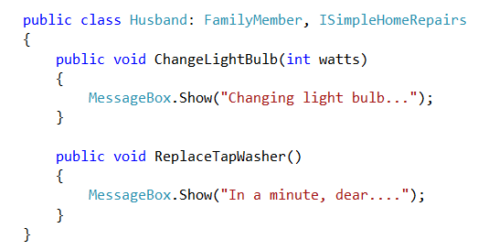
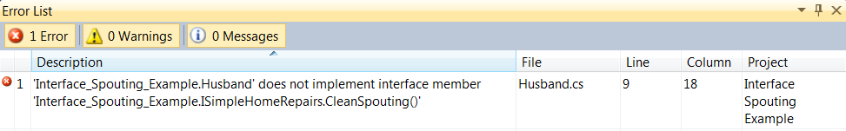
Implementing an Interface
Notes:
You can of course add all the methods manually if you wish, but make sure you get them all.
Here’s what happens if you leave one out – in this case, the husband does not want to have to clean the spouting…
You get a compilation error.
Thus the compiler enforces the contract: If a class says it is going to implement an interface, it must do so. Thus any user of that class can call all the methods in the interface with complete confidence.

Slide 9
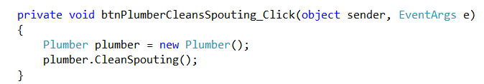
Using an Interface Method
Notes:
This is the most basic usage.
However, remember that an interface is a type. This gives you many very useful options when working with interfaces….

Slide 10
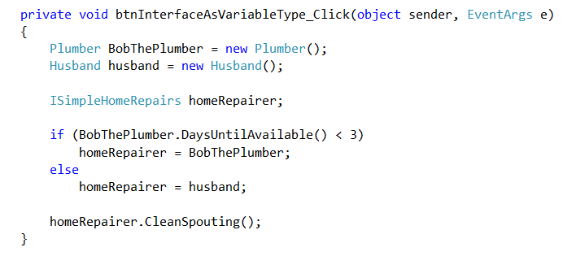
Interface as variable type
Notes:
You can also do this….
Since ISimpleHomeRepairs is a type, you can declare a reference variable of that type (i.e. a pointer to an instance of that type)
The reference variable homeRepairer can be used to refer to any object that implements ISimpleHomeRepairs, regardless of its class.
As shown here, we can make that assignment dynamically.
It is also perfectly legal to say homeRepairer = new Plumber(); if that’s what you need to do.

Slide 11
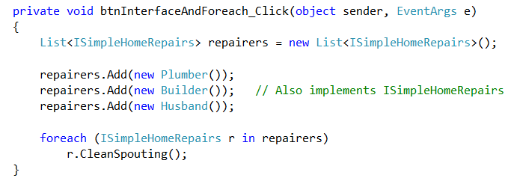
Interface as variable type
Notes:
So of course you can do this.
The example breaks down a little here, but you can see the logic
The list hold things that implement ISimpleHomeRepairs. It doesn’t care about the class of those objects
You can fill it full of different classes, as long as each of them implements the interface.
Then you can loop and call and interface method because it is a method they are guaranteed to have.

Slide 12

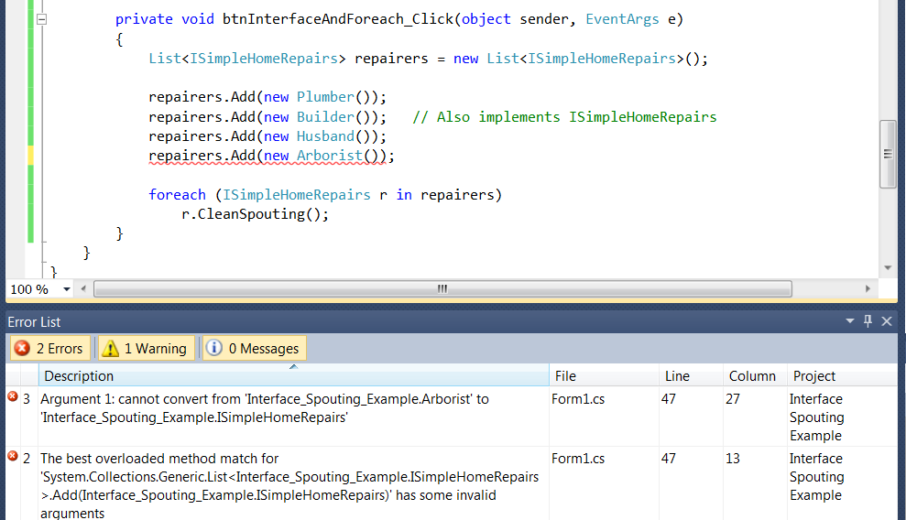
Interface as variable type
Notes:
Imagine we have this class.
The Arborist is a HomeMaintenancePerson, so s/he has all the fields and methods common to that family, but s/he does not do simple home repairs, so does not implement that interface.
What if we try to add an arborist to our list?...
Not allowed, because arborist doesn’t implement ISimpleHomeRepairs

Slide 13
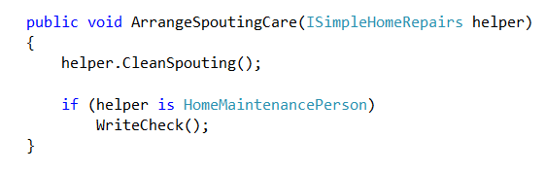
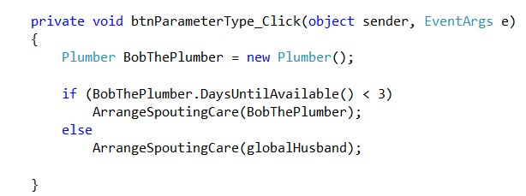
Interface as parameter type
Notes:
And there’s more.
Here we see that we can use an Interface as a parameter type, greatly increasing the flexibility of our methods.
Effectively, you have a method that can accept instances of different classes as long as they expose the method(s) we want to use.
Comes in very handy and, as we will see, this is a core feature of a very important design pattern.
Here’s an example method that will take any argument of any class type, as long as it implements ISimpleHomeRepairs
It calls the CleanSpouting method with complete confidence.
Note then that, since you can take lots of different classes, you sometimes will need to be able to disambiguate class membership to take further action, which could include calling class methods.
Remember we can have lots of classes implementing an interface, but those classes will still have all their own individual methods. We have to know what class something is to know what methods it exposes.
C# provides for this the “is” operator. We will see some more complex uses of it in a moment.
So in this example, either a husband or a homeMaintenancePerson can clean the spouting, but we only write a check if it’s a HomeMaintenancePerson.

Slide 14
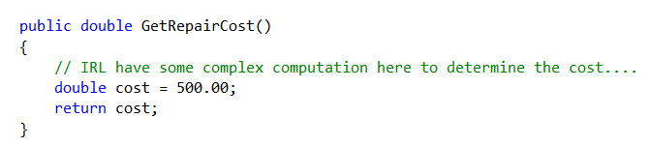
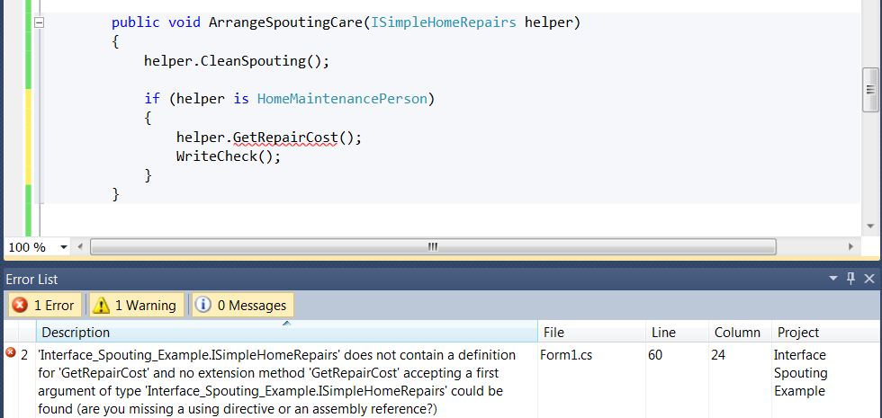
Using the is and as Operators
Notes:
In the previous slide, we detected the type (class) of the helper using is, then wrote the check if needed.
More realistically, we would call some kind of method on the helper, perhaps to get the cost of the repairs before writing the check.
Let’s say that the HomeMaintenancePerson base class has this method GetRepairCost()
Now, before writing the check, I want to call getRepairCost on the helper. So I try this….
Nope. That won’t compile. The error message tells me that ISimpleHomeRepairs doesn’t expose GetRepairCost
The problem is that I asked “is helper a HomeMaintenancePerson” and the system said “Yes”, but that’s all it did.
It didn’t modify its own understanding of the type of helper.
As far as it’s concerned, helper is still just known to be some guy who implements ISimpleHomeRepairs (that’s its type in the function header, after all).
So we have to give more explicit instructions.
That is done like this…

Slide 15
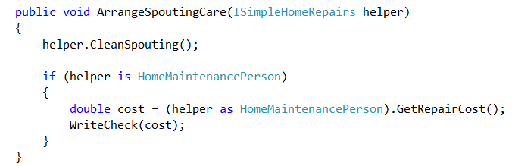
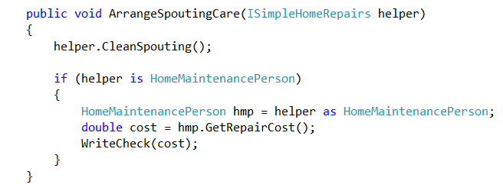
Using the is and as Operators
Notes:
I’ve changed the WriteCheck method to take the cost as an argument…
These two forms work identically, but some people find the second easier to read
The “as” operator is a cast. It tells the compiler that the argument is in fact of the specified type and it is ok to call the methods of that type.

Slide 16
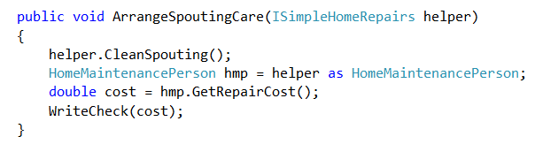
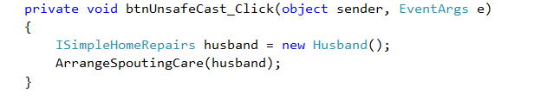
Using the is and as Operators
Notes:
Note that the compiler assumes you know what you are doing.
If we take out the “is” part and just cast and call, what do you think happens if we actually call ArrangeSpoutingCare passing in a Husband object (which is perfectly legal).
The helper.CleanSpouting part works fine. The cast works fine. But when the system calls GetRepairCost, Husband doesn’t actually have that method (recall that it is a class method of HomeMaintenancePersons, and husband is not of that class), you get this…

Slide 17
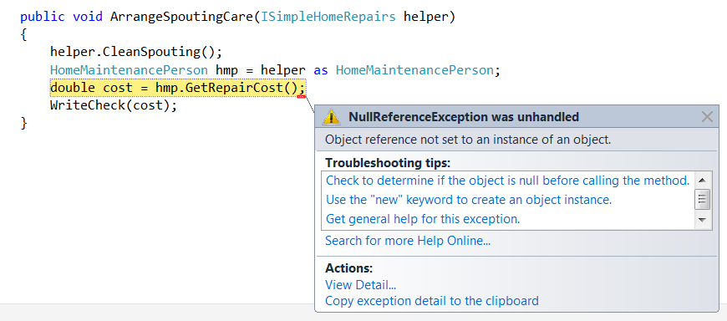
Using the is and as Operators
Notes:
So always is before you as.

Slide 18
Interface vs. Abstract Class
Use an abstract class if:
You are modelling common data.
You want to provide default implementations for any methods.
You expect to modify the base class (e.g. add new methods) in the future.
Use an interface if:
None of the above apply
You are modelling a “concise bit of functionality.” – Microsoft
You are modelling a functional set that will be used by many different classes.
You want to implement “multiple inheritance” of method sets.
You need the flexibility of mixing classes (as discussed earlier).
Class => “is a”
Interface => “can do”
Notes:
Here’s another question you should be asking yourself: What is the relationship/difference between interface and an abstract class?
Remember what an abstract class is: It is a base class that provides no code for one or more of its methods. That base class specifies these “abstract” methods, but the descendants have to provide code for each one.
Thus, logically, an interface is simply an abstract class that has no fields and only abstract methods.
How do you decide when to use which?
Abstract class is:
There is data, not just methods. Interfaces cannot do data (although they can do properties….)
Interfaces cannot provide any code.
Think about what happens if you need to add a method to an interface. Every class that implements that interface must be modified, because it must implement all the contained methods. However, if you just want to add a method to a base class, you don’t need to change any code for descendants who don’t care about the new method. They’ll have it, but it won’t matter to them.
Spend some time thinking about this. Which is more coupled? (Class). Which is more flexible? (Class). What does each do?
Ponder it for awhile and you will see that classes are best for modelling things and interfaces are best for modelling behaviours.

Slide 19
If Interested….
Cwalina, K. & Abrams, B., Framework Design Guidelines: Conventions, Idioms, and Patterns for Reusable .NET Libraries. Addison-Wesley, 2009.
At Robertson: 005.2768 NET C 2009
Notes:
If you find these sorts of questions interesting, both from the implementation viewpoint and from the perspective of a language designer, you might enjoy this book. It’s a sort of chatty presentation of things like interface or abstract class, specifically in a .NET context.

Slide 20
Optional Slides
Multiple Inheritance

Slide 21
Practical

Slide 22
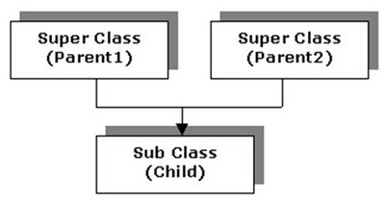
Multiple Inheritance
Allowing a class to inherit simultaneously from more than one parent class.
Notes:
A programming language design theory issue...
http://javacircuit.blogspot.co.nz
The child has all the fields and all the methods of both parents.
Some languages allow this: LISP, Perl, Python, some versions of C++
C# does not. (Neither does Java).
Having or not having MI is an important language design decision.
Languages that allow it do so because it is a powerful tool for modelling certain kinds of computational situations.
For example…

Slide 23
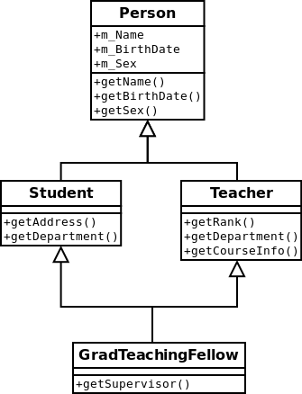
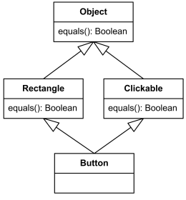
Multiple Inheritance - Pro
Notes:
Here are some classic examples.
Rectangle is a sensible class; Clickable is a sensible class. Each has common fields and methods that one might wish to encapsulate.
A button, is a clickable rectangle, therefore it is sensible for it to simply inherit from both base classes.
Similarly, where you have graduate teaching assistants, they are both students and teachers, and this is a sensible way to express that.

Slide 24
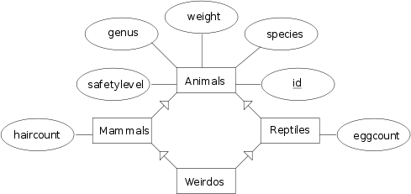
Multiple Inheritance
Notes:
MI allows you to elegantly handle some very difficult, but real, data representation problems.
Specifically, the platypus.
http://en.wikibooks.org/wiki/File:DMiB_multiple_inheritance.svg

Slide 25
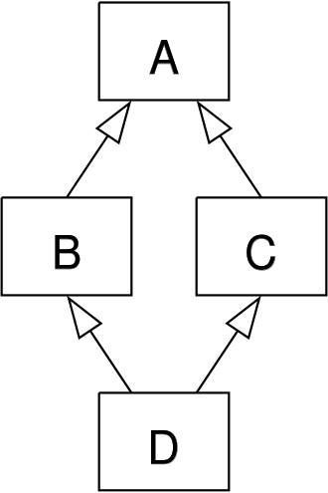
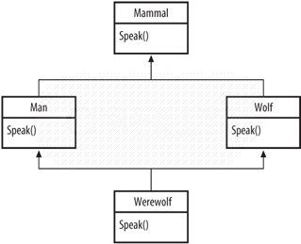
Multiple Inheritance - Con
Notes:
Languages that disallow MI do so because of the potential for ambiguities to arise.
This is the most commonly discussed one: the diamond problem.
A defines a virtual method m()
B and C descend from A and each override m().
D does not override the method. When we say InstanceD.m(), which one do we mean?
Here’s a not-terribly-realistic example...you should be able to extrapolate.
http://commons.oreilly.com/wiki/index.php/Beyond_Java/The_Perfect_Storm.
So Java and C# have decided it is too dangerous to permit multiple inheritance.
Fortunately, with interfaces, you can achieve many of the same results. Specifically, you can basically get MI for methods.

Slide 26
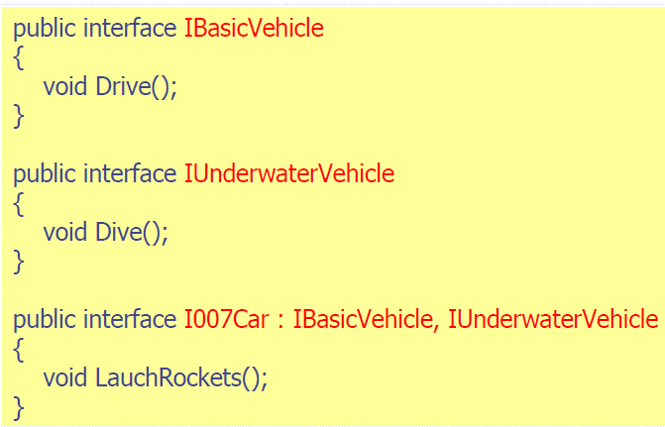
Multiple Inheritance (sort of) with Interfaces
Notes:
Because a class can implement multiple interfaces, you can group common functionality not into base classes, but into interfaces.
A class can then implement as many interfaces are required.
Here is an example from COM and .NET Interoperability By Andrew Troelsen. “A James Bond car is a submergible sports car.”

Slide 27
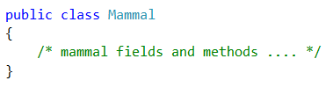
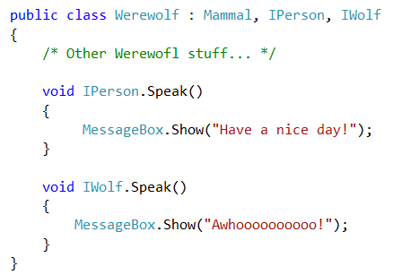
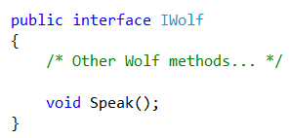
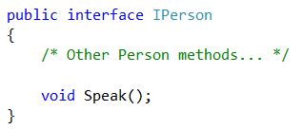
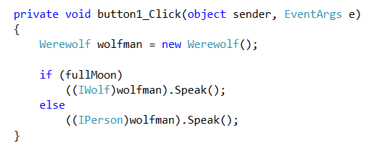
Multiple Inheritance (sort of) with Interfaces
Notes:
The question you should be asking is: But what about situations where two interfaces include methods with the same prototype?
There is nothing in the syntactic rules to prevent this.
Isn’t it the diamond problem again?
That is a good question. Fortunately the designers of C# thought of this problem, and included “Explicit Interface Implementation”
The syntax is just a little fussy, so work carefully.
We illustrate with our werewolf example.
Werewolf descends from Mammal and implements both IWolf and IPerson.
To resolve the naming clash, preface the two Speak() method implementations with their interface.
Then call, as shown…
Assume that fullMoon is a global boolean initialised by reading some meteorological database
Note the casts. They are required. (Alternatively, use ‘as’, but you must cast.)

